Slide 1


SIMATS ENGINEERING
Saveetha Institute of Medical and Technical Sciences
Chennai - 602105
DSA0304 - NATURAL LANGUAGE PROCESSING
“ Evolution of NLP - From rule based systems to modern NLP ”
Supervised by:
Dr. T. Devi
Dr. N. Deepa
Presented by:
G. Srilakshmi
192425006

Slide 2
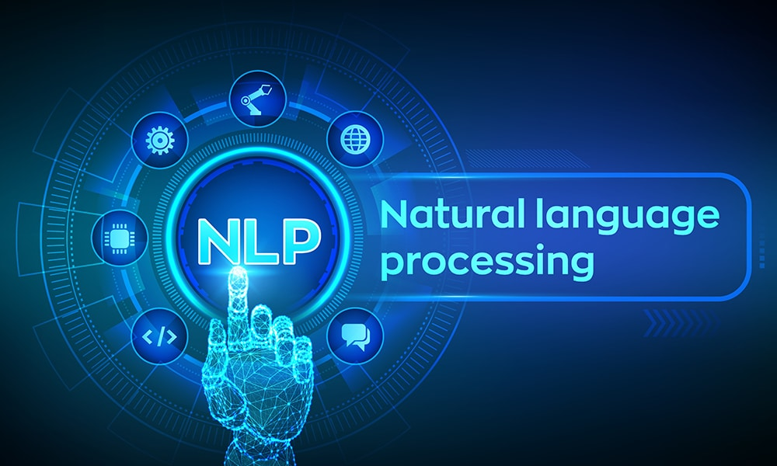
INTRODUCTION
What is NLP ? Natural Language Processing (NLP) is a branch of Artificial Intelligence (AI) that enables computers to understand, process, and generate human language.
Why is NLP Important?
Enables human-computer interaction
Processes text and speech
Automates language-related tasks

Slide 3
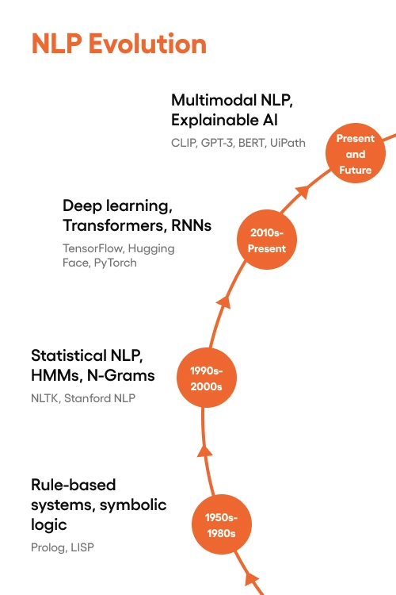
EVOLUTION
1. Rule-Based NLP (1950s–1980s)
Based on manually written grammar rules.
Worked well for simple tasks.
2. Statistical NLP (1990s)
Used probabilities and large text datasets.
More flexible than rule-based systems.
3. Machine Learning NLP (2000s)
Learned patterns automatically from data.
Improved translation and text classification.
4. Modern NLP (2018–Present)
Uses Deep Learning and Transformer models.
Better understanding of context and meaning

Slide 4
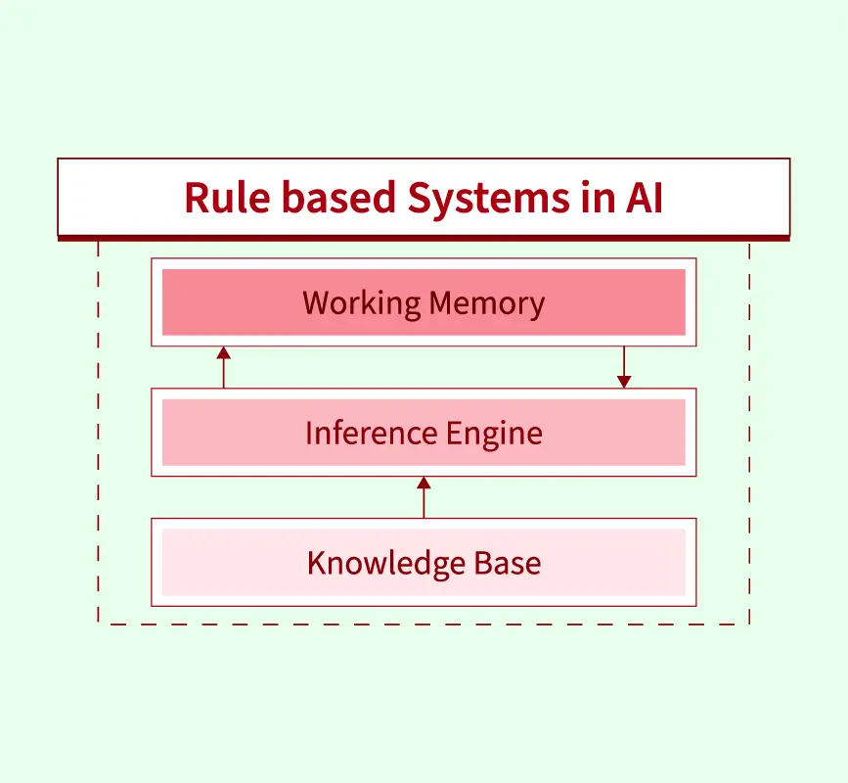
RULE BASED
Rule-Based NLP uses predefined linguistic rules created by experts to process language.
Advantages
Easy to understand
Predictable results
Suitable for small applications
Features
Uses grammar and dictionary rules
No learning from data
Best for simple and structured tasks

Slide 5
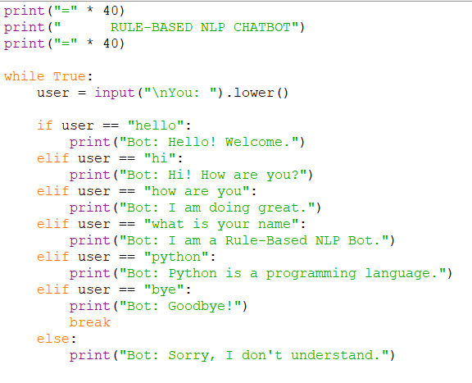
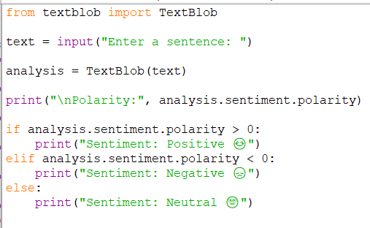
INPUT

Slide 6
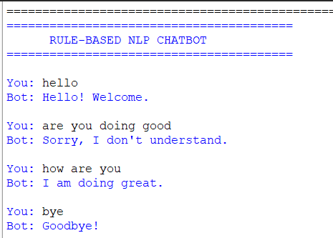
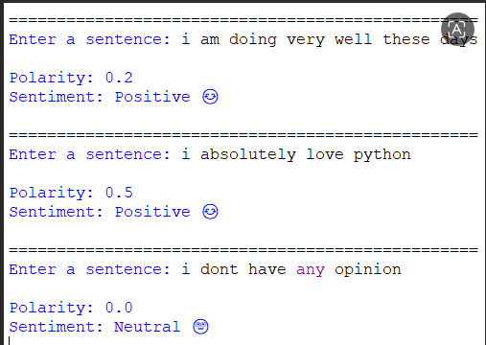
OUTPUT

Slide 7
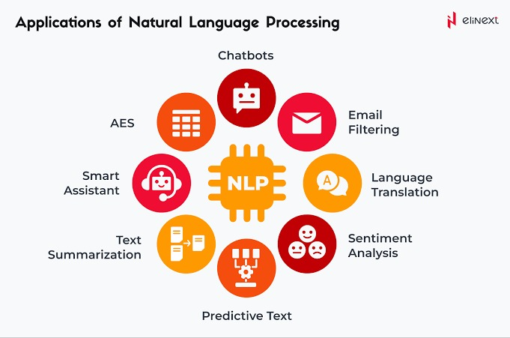
APPLICATIONS
Common Applications
Chatbots and Virtual Assistants
Machine Translation
Speech Recognition
Sentiment Analysis
Spam Email Detection
Text Summarization
Search Engines
Grammar Checking

Slide 8
CONCLUSION AND FUTURE SCOPE
Conclusion
NLP is a branch of AI that helps computers understand human language.
It has evolved from simple rule-based systems to advanced AI models.
Modern NLP provides higher accuracy and understands context better.
NLP is widely used in healthcare, education, business, customer service, and many other industries.
Future Scope
More intelligent AI assistants
Better multilingual communication
Smarter automation and personalized user experiences

Slide 9
THANK YOU

